Slide 1
LADIES DENIM STOCK
ETL-001
DATE: 18-02-2026

Slide 2
STYLE: LADIES DENIM PANTS
QUALITY: 99% Cotton 1% Spandex weight 10.50 oz
QUANTITY: 24750 Pcs
BRAND: Studio 33
Please note that the goods are cancelled and currently on the port.

Slide 3
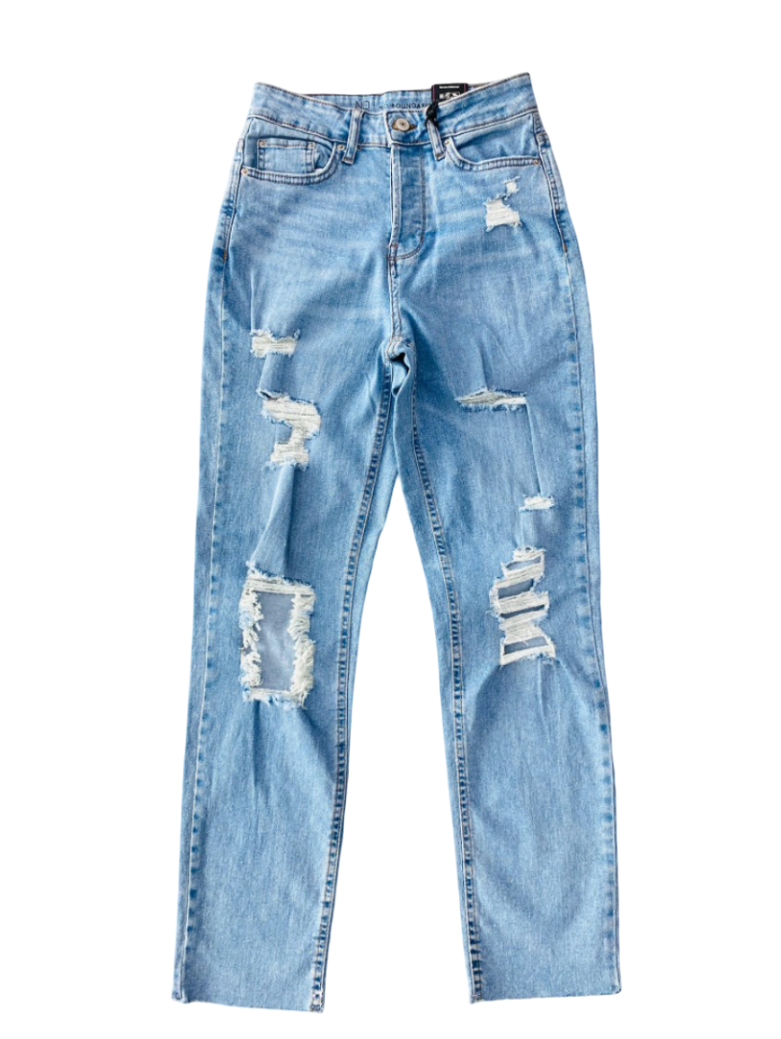
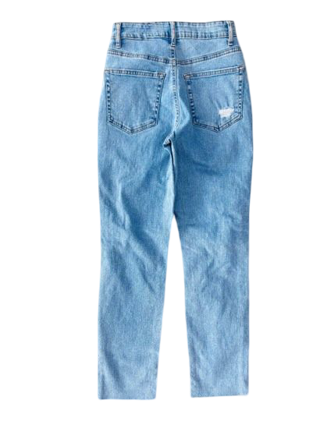
Dark wash

Slide 4
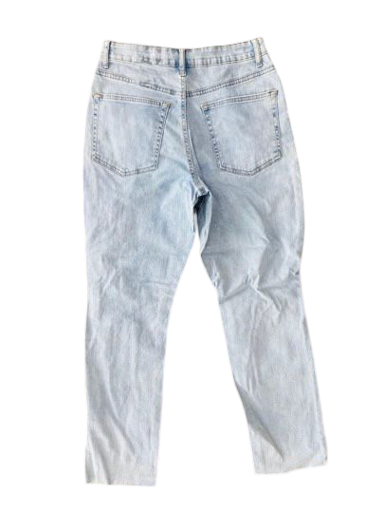
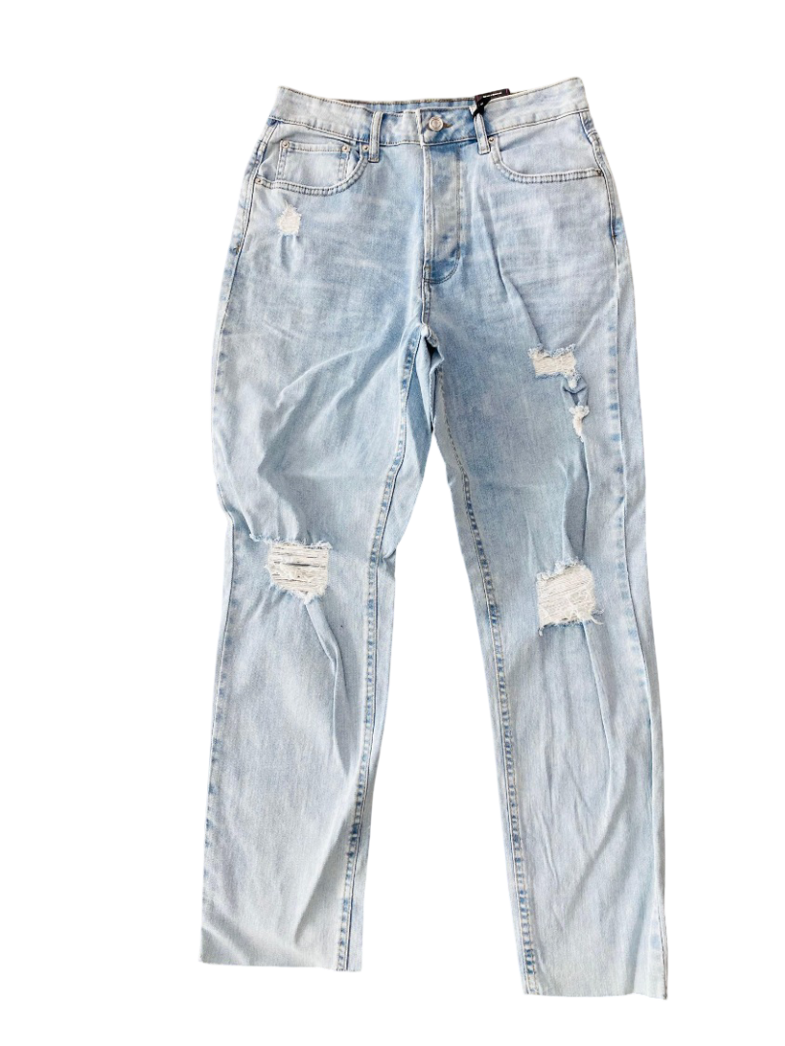
Light wash

Slide 5
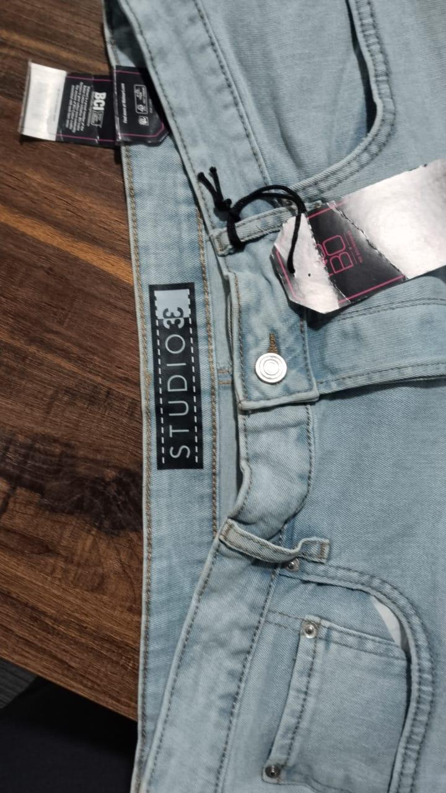
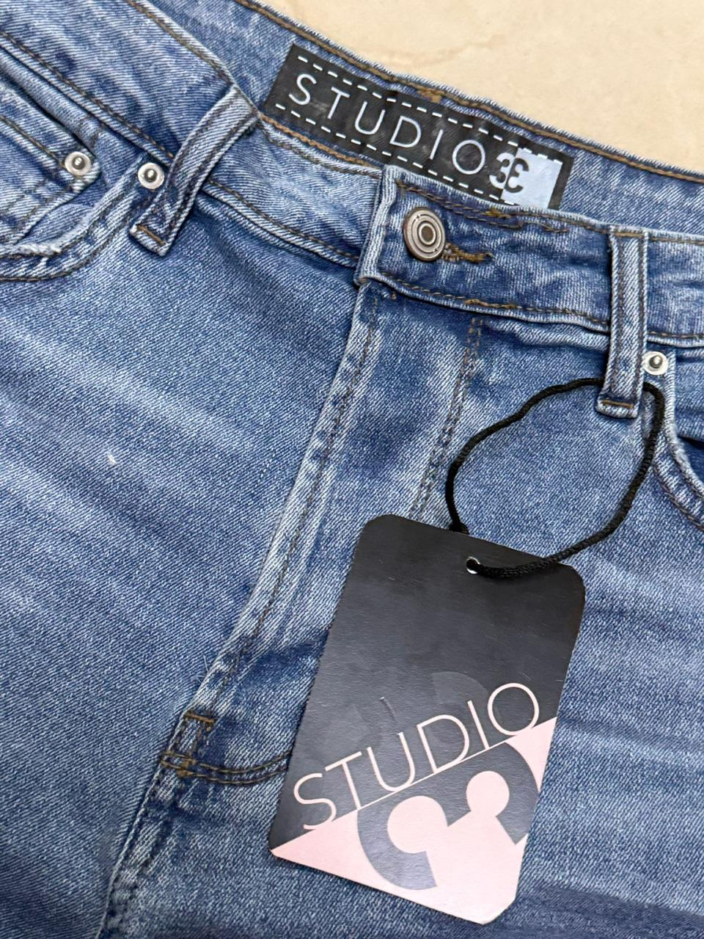
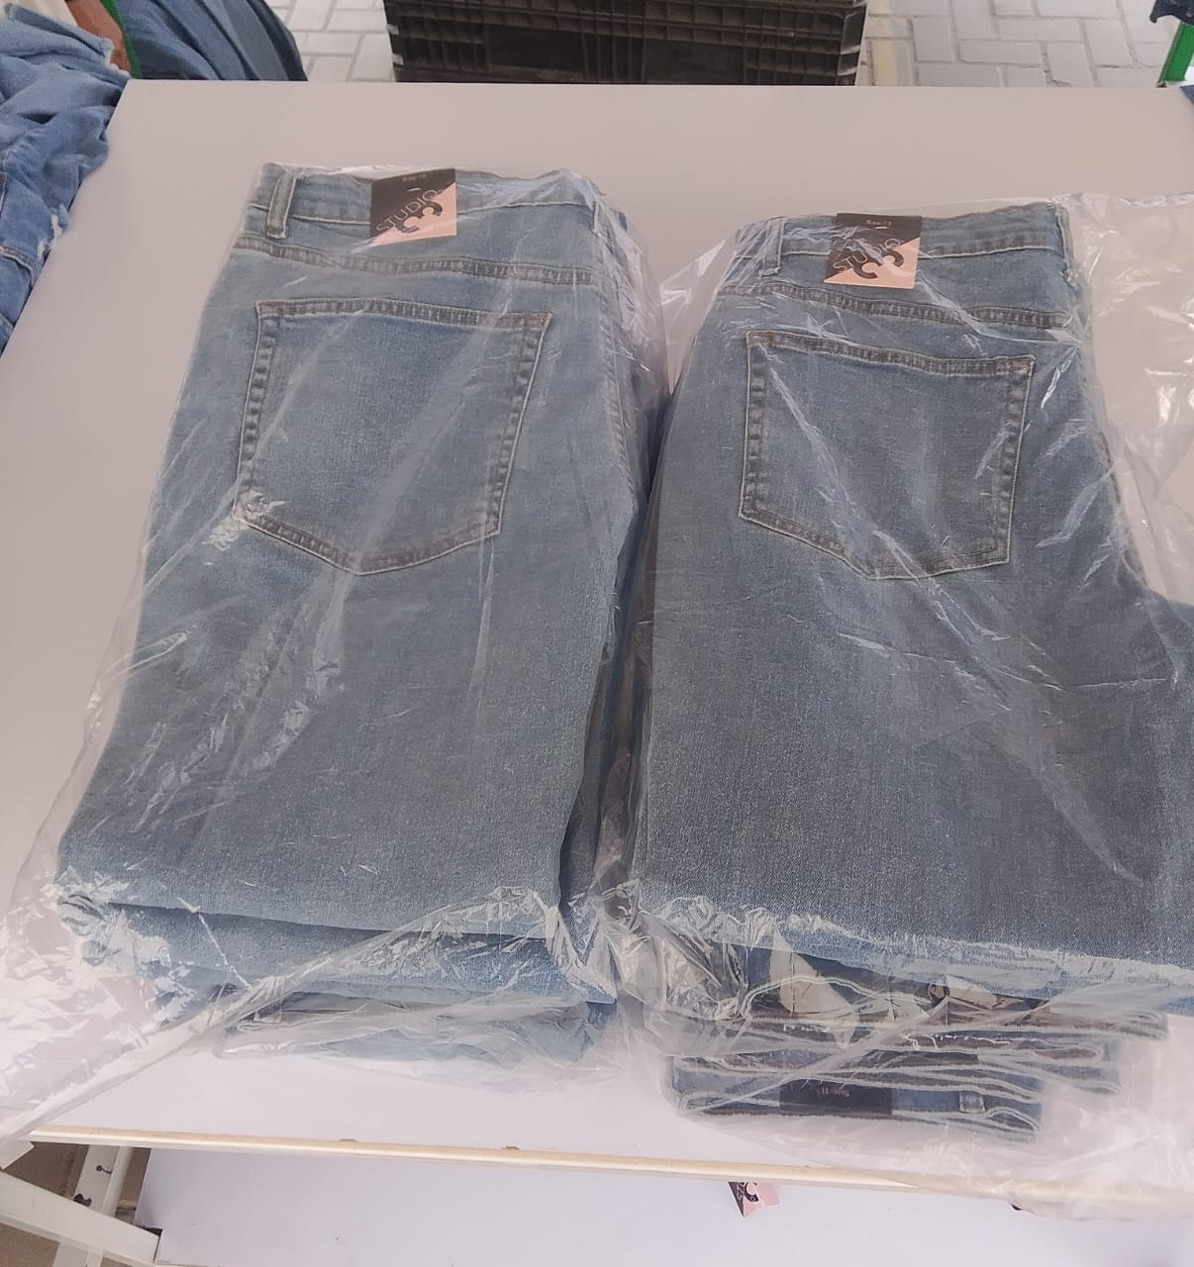
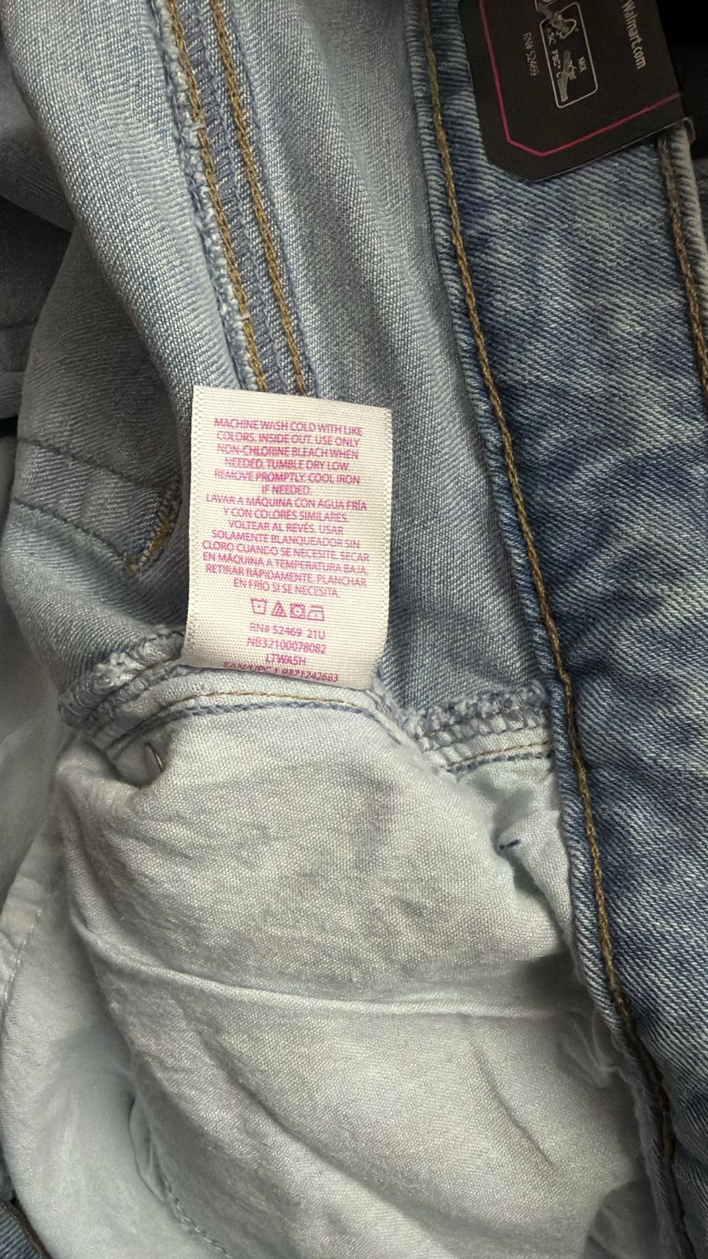
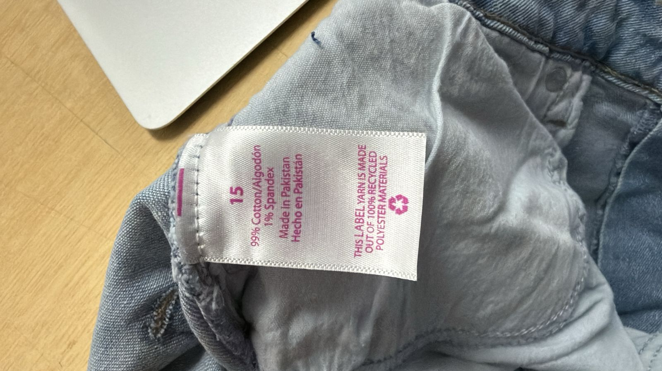
Packing and labeling

Slide 6
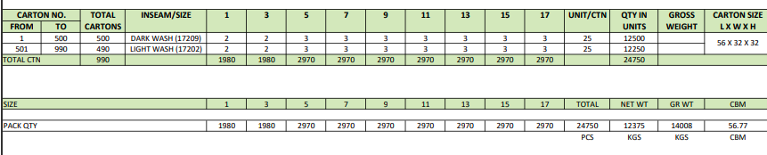
Packing list

